Slide 1

Sentiment Analysis
Ishan Singh (MDS202119)
Rajas Vaidya (MDS202131)
Shreyansh Rastogi (MDS202140)
Sucheta Jhunjhunwala (MDS202151)

Slide 2
Meet our team
Ishan Singh
Shreyansh Rastogi
Sucheta Jhunjhunwala
Rajas Vaidya
Data exploration and basic ML models
Building basic ML models and Creating a docker container
Visualization and presentation
Building a LSTM model

Slide 3
Agenda
1
2
3
4
5
Introduction
Challenges and applications
ML models used
Docker
Conclusion

Slide 4


Introduction
Sentiment analysis, also referred to as opinion mining, is an approach to natural language processing (NLP) that identifies the emotional tone behind a body of text.
Sentiment analysis can be defined as analyzing the positive or negative sentiment of the customer in text.
The contextual analysis of identifying information helps businesses understand their customers’ social sentiment by monitoring online conversations.
Your response time is really bad.
I’ve been waiting over a month.
Customer support is amazing,
love how the platform works.

Slide 5
Sentiment Analysis can provide valuable insights into customer feedback, market trends, and public opinion, among other things.
It can help organizations in identifying potential issues and risks, and to make informed decisions based on data-driven insights.
Without sentiment analysis, businesses and organizations would have a limited understanding of customer needs and preferences
Why do we need Sentiment Analysis?

Slide 6

How does Sentiment Analysis work?
Label
ML
Classification
Algorithm
Training
Preprocessing
Feature
Extractor
Features
Prediction
Feature
Extractor
ML
Classifier
Features
Label

Slide 7



Challenges
?
Ambiguity
Context and domain adaptation
Defining neutral
Data quality and bias
Subjectivity and tone
Human annotator accuracy

Slide 8





Monitor customer feedback and improve brand reputation
Enhancing Customer service experience
Applications
Social media analysis and opinion mining
Market Research and Analysis
Finance and stock market

Slide 9
Basic ML Models used
Logistic regression
Models the relationship between the features and the target variable using a logistic function
Provides interpretable results in terms of feature importance
We achieved 76.7% accuracy with the logistic regression model
SVM
Widely used in sentiment analysis, aspect-based sentiment analysis, and opinion mining.
Good performance in handling high-dimensional and sparse data, can handle non linear decision boundaries
We achieved 84.4 % accuracy with the SVC model
Naïve Bayes
Probabilistic machine learning algorithm commonly used in sentiment analysis.
Sensitive to the presence of irrelevant features
We achieved 71.15% accuracy with the multinomial naïve bayes model

Slide 10
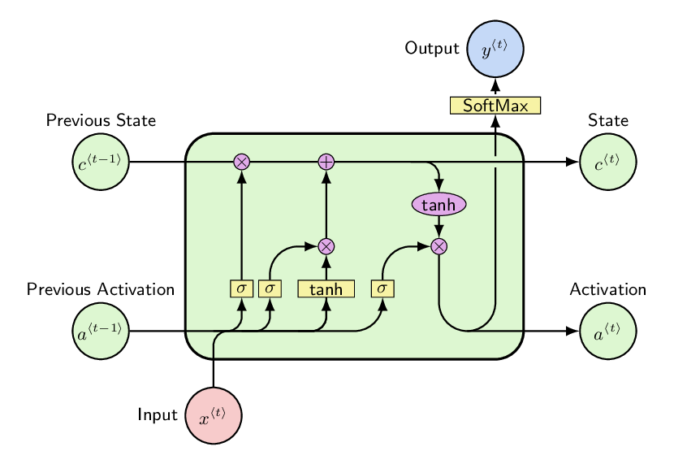
LSTM
A type of recurrent neural network (RNN) commonly used in sentiment analysis.
Handles sequential data, such as text, speech, and time series data.
Good performance in handling long-term dependencies in sequential data
Structure:- Input gate, Forget gate and output gate
Captures the contextual and semantic information of words
We achieved 97.2% accuracy with the LSTM model

Slide 11

Docker
Portability
Scalability
Security
Consistency
Efficiency

Slide 12
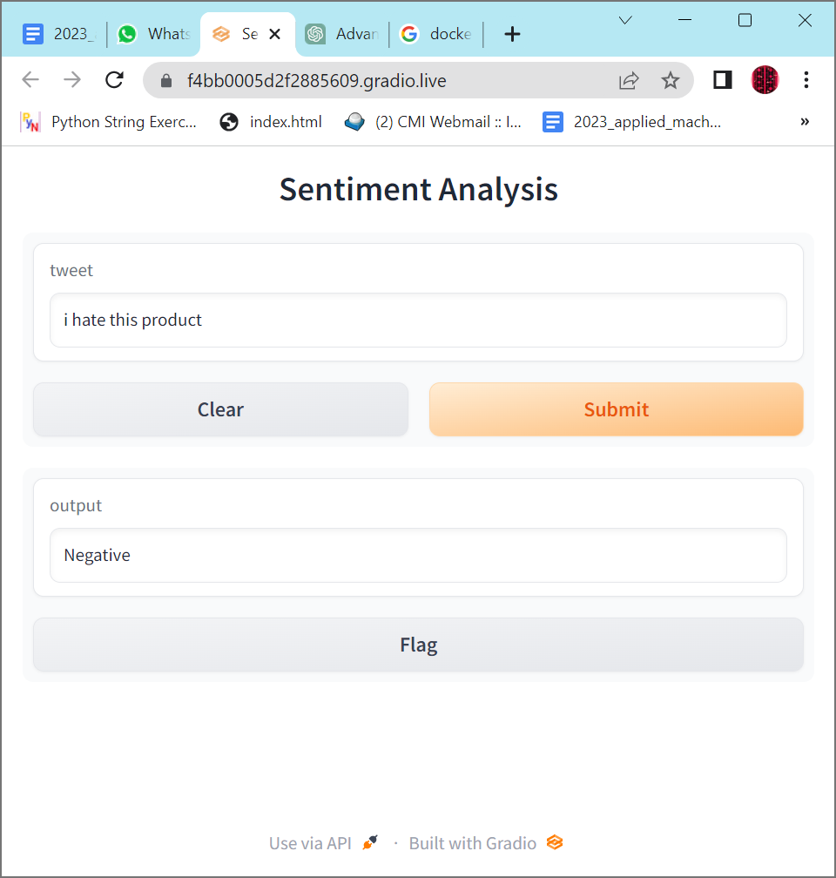

Results

Slide 13

Conclusion
Model | Accuracy
Naïve Bayes | 71.15%
Logistic Regression | 76.7%
SVM | 84.4%
LSTM | 97.2%
GitHub Repository Link: https://github.com/SuchetaJ/Sentiment_Analysis
In conclusion, the sentiment analysis project using ML and DL techniques was successful in analyzing the sentiment of a given text.
LSTM works best with our dataset for sentiment analysis.

Slide 14
Thank you

